Slide 1


Teach a child to read and keep that child reading and we will change everything.
And I mean everything.

Slide 2

Who is Read Write Inc. for?
ALL children who are learning to read!
Read write inc starts on day 1 in Reception.
Children remain on the RWI programme until they can read confidently.

Slide 3

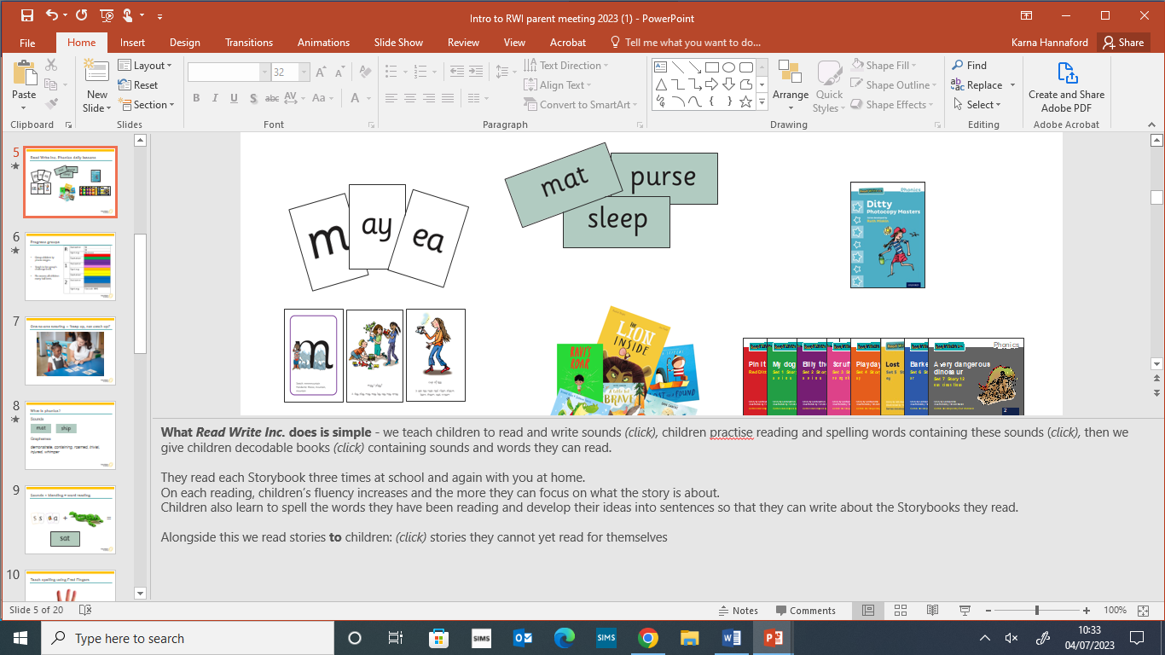


What is Phonics?

Slide 4
Which sounds will my child learn?
Single letter sounds first
Once children know all 26 sounds
They begin set 2 sounds
Special Friends
2 letters making 1 sound

Slide 5
Set 3 sounds
Same sound – different letters
Year 1
Alternative spellings

Slide 6
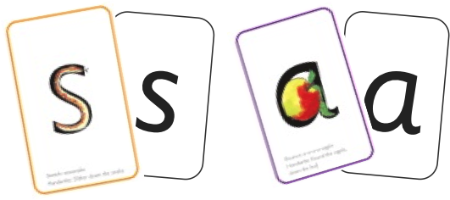
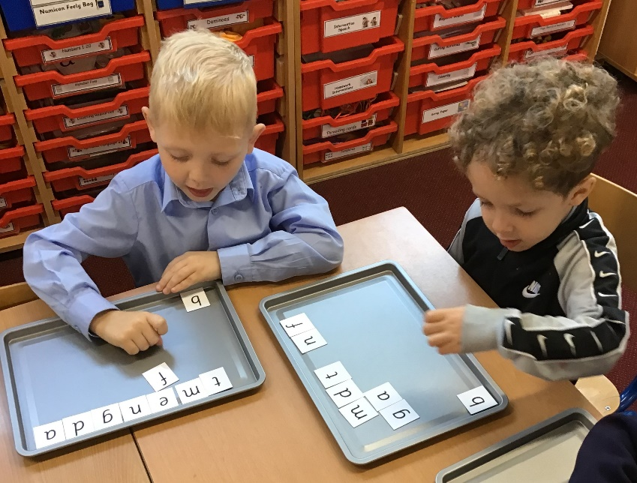
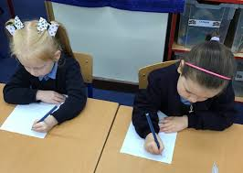
What does a daily lesson look like?...before blending.
Teach children a new speed sound.
Practice writing new sound
Start to make words with learnt sounds.
Teach children a new speed sound.
Read Green words
Write Green words

Slide 7


What does a daily lesson look like?...when blending.
Teach children a new speed sound.
Read Green words
Write Green words
Read story and speedy green words from storybook
Read red words
Read storybook in pairs

Slide 8
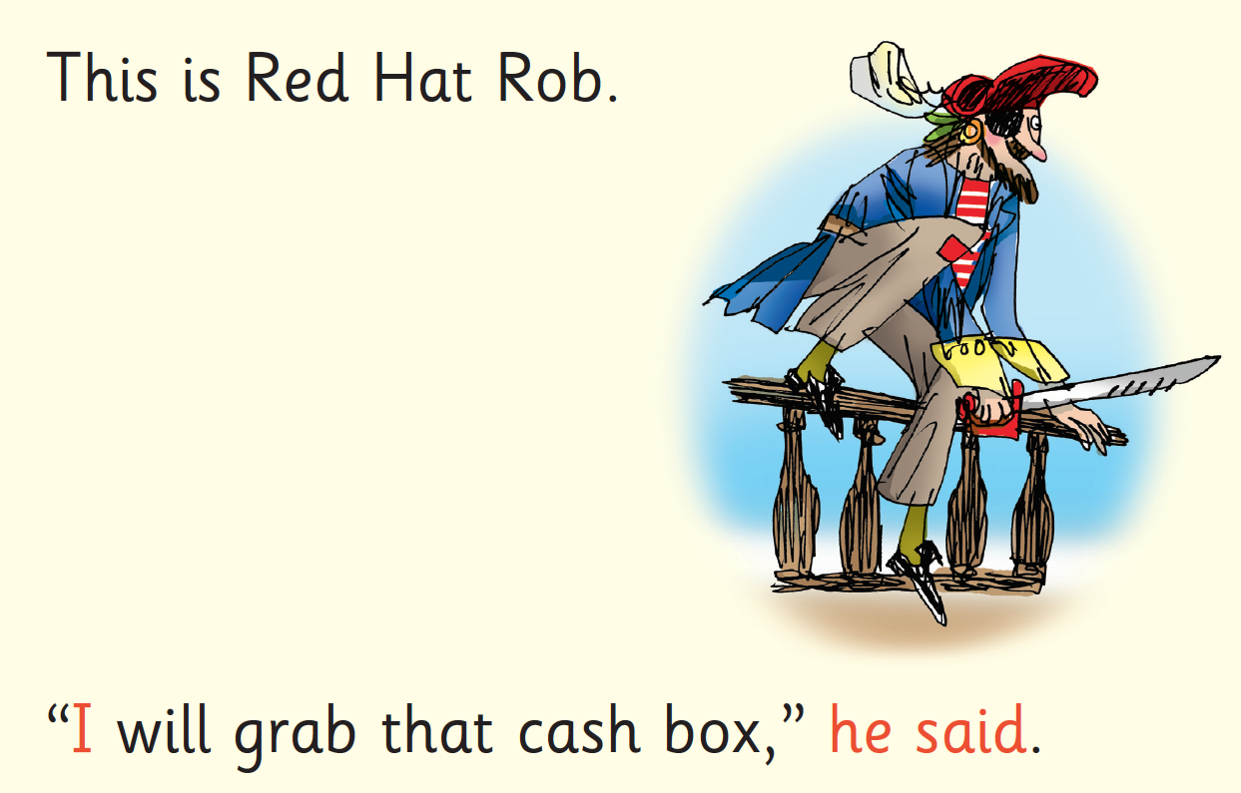

Red Words
Tricky words – NOT to be sounded out. Children need to sight read these words.

Slide 9
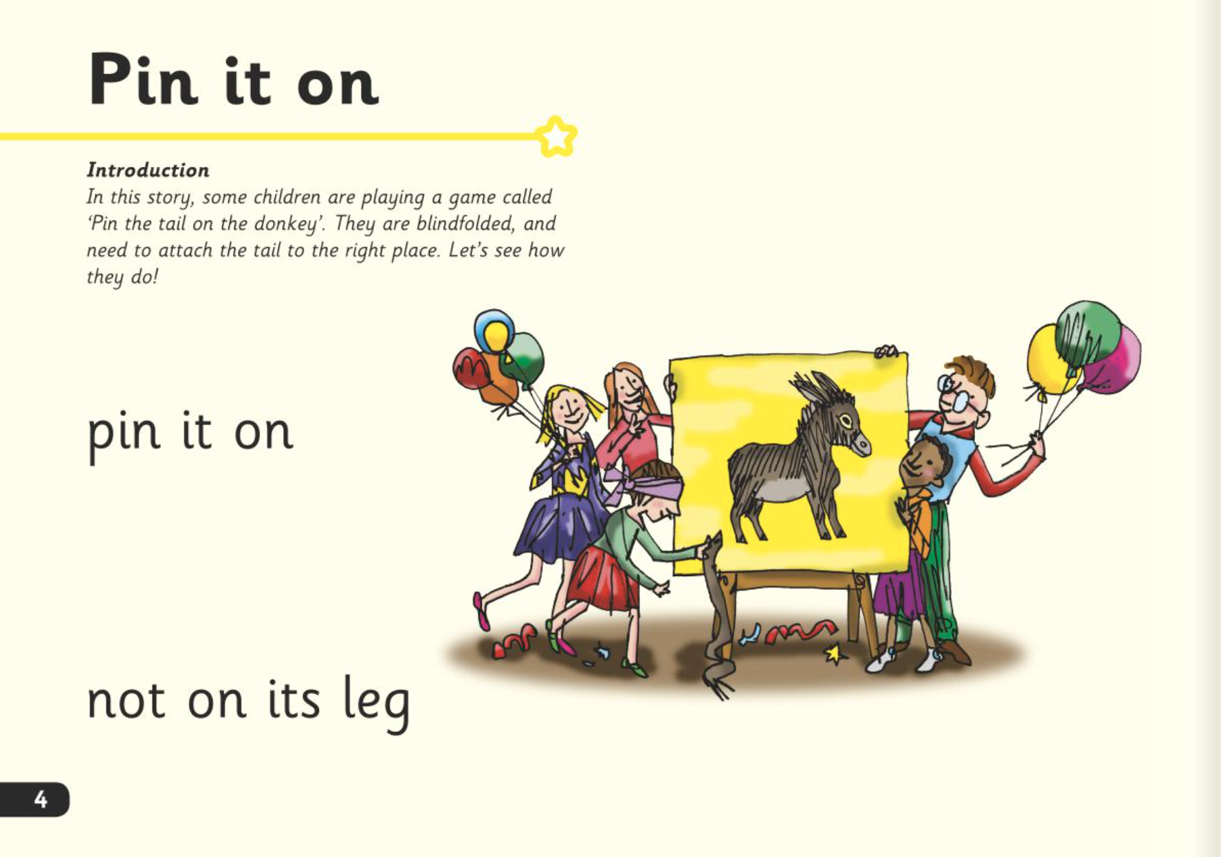



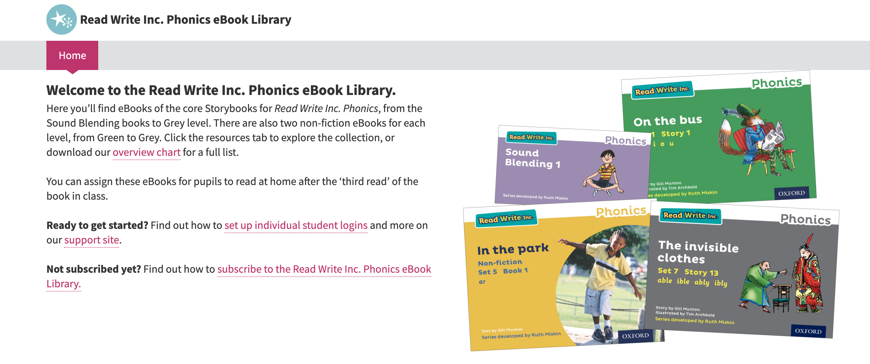
What will my child read at home?

Slide 10
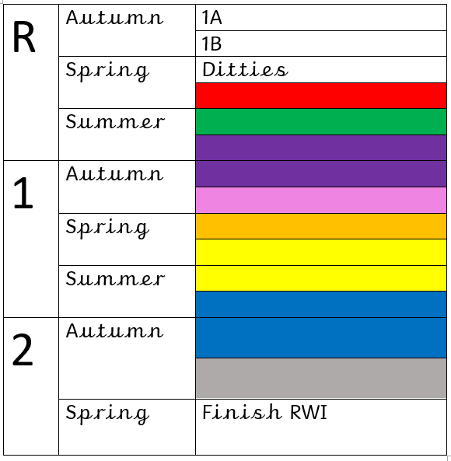
Where should my child be?
This is the expected progress of children across Key Stage 1.
Yellow and blue are tested on fluency not just blending.
Children can spend longer here.

Slide 11

What if my child is falling behind?
One to One tutoring
Daily pinny time
Oral blending
Daily reading

Slide 12
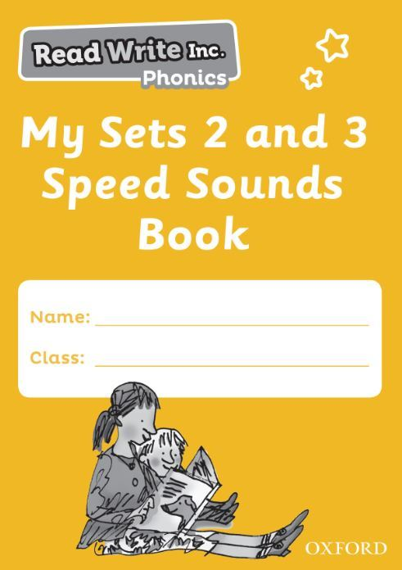
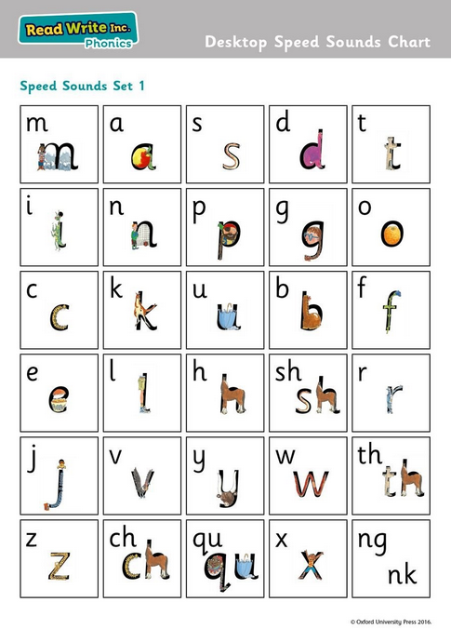
How can I help at home?
1. Use pure sounds rather than letter names.
2. Use Fred Talk to help your child to read and spell words.
3. Listen to your child read their Storybook every day.
4. Read stories to your child
every day.

Slide 13

Any Questions?

